Slide 1
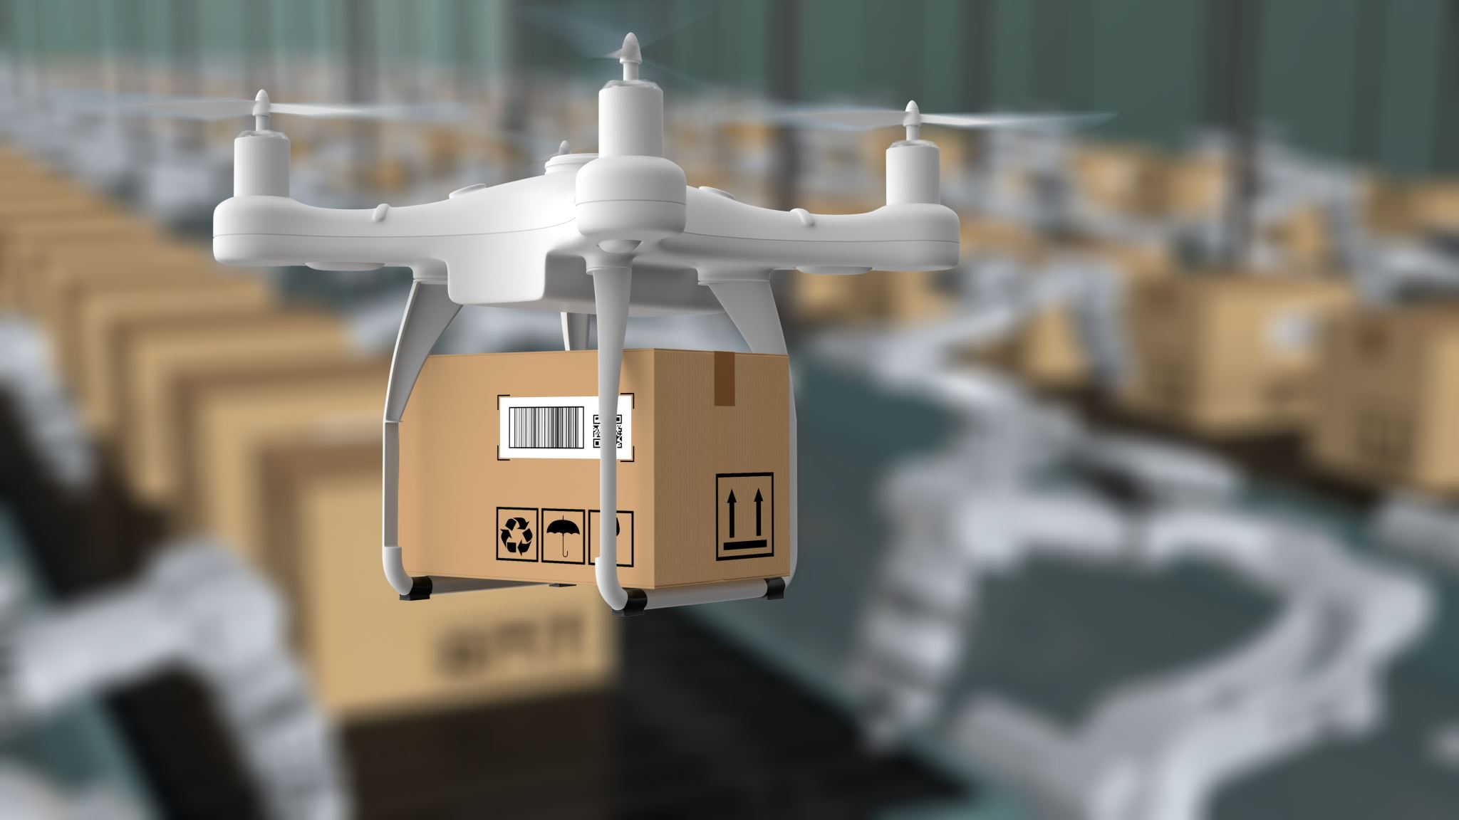
E-Commerce Product Comparison Tool
Welcome the audience and introduce yourself.
Briefly set the stage: "This project was developed to simplify the online shopping
experience by combining product comparison and Wishlist management into a unified tool."

Slide 2
Introduction
Project Overview:
"Our tool is a web application designed to streamline shopping by enabling users to compare products from multiple platforms and maintain a wishlist."
Goal:
"Provide users with a quick, reliable, and user-friendly way to find the best deals and keep track of items they’re interested in."
Problem Solved:
"Online shopping often involves navigating multiple platforms and manually tracking products. This tool centralizes and simplifies these tasks."

Slide 3

High-Level Design
Architecture:
Client-Server Model:
Frontend: Built with HTML, CSS, and JavaScript.
Backend: Node.js and Express.js for handling requests and routing.
Database: MongoDB for storing wishlist items.
Interaction Flow: User → Client (browser) → Server (API requests) → External APIs (ASOS, Real-Time Search).

Slide 4

Technologies Used
Frontend: HTML, CSS, JavaScript.
Backend: Node.js, Express.js, Axios for API integration.
Database: MongoDB with Mongoose for schema design.
APIs: ASOS API and Real-Time Product Search API for fetching product details.

Slide 5
Visuals:
Add a diagram showing:Frontend communicates with Backend (Node.js).
Backend fetches data from external APIs and MongoDB.
Data flows back to the frontend for display.

Slide 6

Key Features
Compare Products:
Users can search for products by name or ID.
Supports multiple APIs for diverse product listings.
Displays product images, names, prices, and reviews.
Wishlist Management:
Add items to a wishlist from the compare page.
View all wishlist items with details like name, price, and reviews.
Delete items from the wishlist with instant feedback.
Interactive UI:
A clean, responsive design ensures accessibility on all devices.
Seamless navigation between pages: Home, Compare, Wishlist, and About Us.

Slide 7
Demo
Home Page:
Welcome message and navigation menu.
Compare Page:
Search for products by entering a name or ID.
Show results fetched from APIs with product details.
Add a product to the wishlist.
Wishlist Page:
Display wishlist items.
Delete an item and refresh the list to confirm the deletion.
Highlight:
Real-time updates when interacting with the wishlist.
Responsive design across different devices.

Slide 8
Future Improvements
Potential Features: User Authentication:
Enable personalized accounts to save individual Wishlist.
Advanced Search Filters:
Include filters for price range, brand, category, and ratings.
Dynamic Notifications:
Alerts for price drops, stock availability, or discounts.
Analytics Dashboard:
Visualize trends in saved wishlist items (e.g., price fluctuations).
Mobile App Integration:
Develop a companion app for on-the-go access.
API Expansion:
Integrate additional e-commerce platforms for more comprehensive comparisons.

Slide 9
Lessons Learned
Challenges Faced:
API Integration:
Try to find a way of handling API rate limits and ensuring proper data mapping.
Database Management:
Designing a flexible schema for wishlist items.
Error Handling:
Ensuring the system gracefully handles API and server errors.
Insights Gained:
Learned the importance of asynchronous operations in JavaScript.
Gained experience in designing full-stack web applications.
Unexpected Outcomes:
API limitations required creative solutions for data validation.
Debugging cross-origin requests during development was a significant learning experience.
Talking Points:

Slide 10

Thank You!

